Slide 1
“BOOK”
Jiang Boqin、Wang Zihui、Lou Xiaohui、 Zhao Maoying

Slide 2
Discovered problems:
As we all know, books we usually read are regular cuboids, opening is the preface, catalogue, text, ending, lack of many interesting and
intuitive manifestations.
Our ultimate goal:
to make books more interesting and intuitive.
How to change:
We transform the title, text and picture information of a book into our own language, and then bind the original book into a new book in our own language, so that the reading form of the book is not so single, and the information is more intuitive.
发现的问题：众所周知，我们平时阅读的书本都是规规矩矩的长方体，翻开便是序言，目录，正文，尾声，缺少了不少趣味性和直观性的体现。
我们的最终目的：想让阅读的书籍便得生动有趣，更加直观。
如何改变：我们把一本书本的标题，正文，图片信息转化成自己的语言，然后用我们自己的语言将原本的书再重新装订成一本新的书，让书阅读形式不那么单一，信息也更加直观。

Slide 3

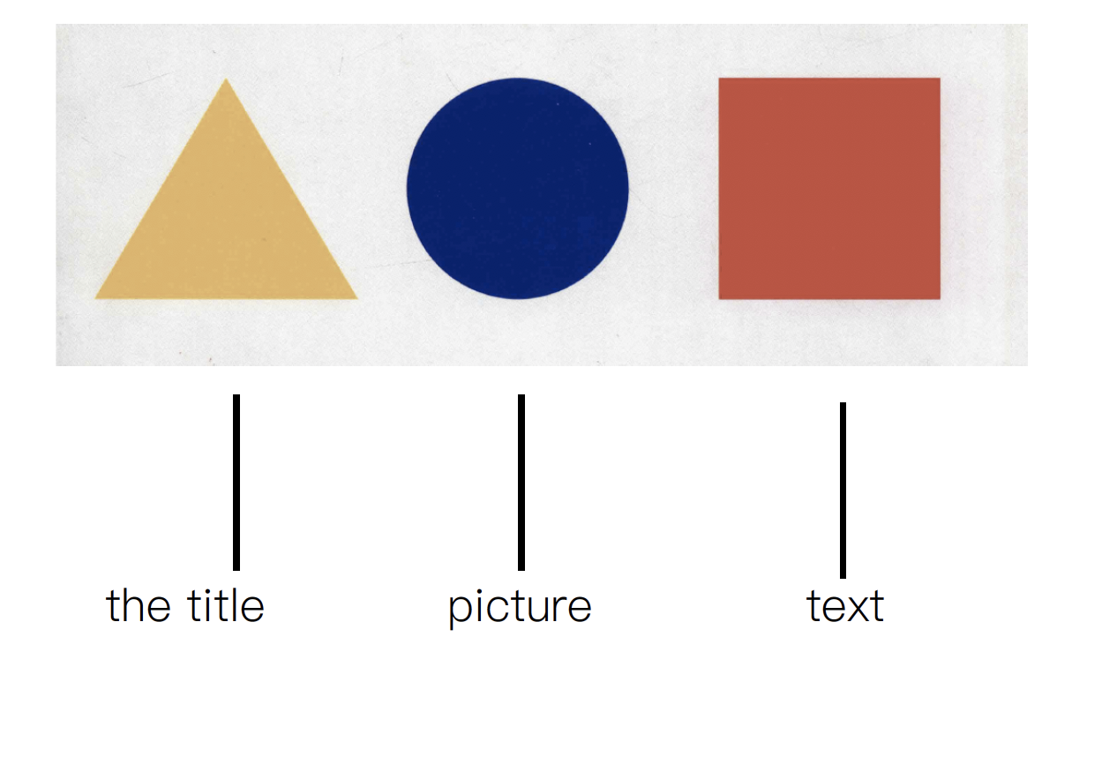
Inspiration
Something I use
“Bauhaus”this book I read

Slide 4
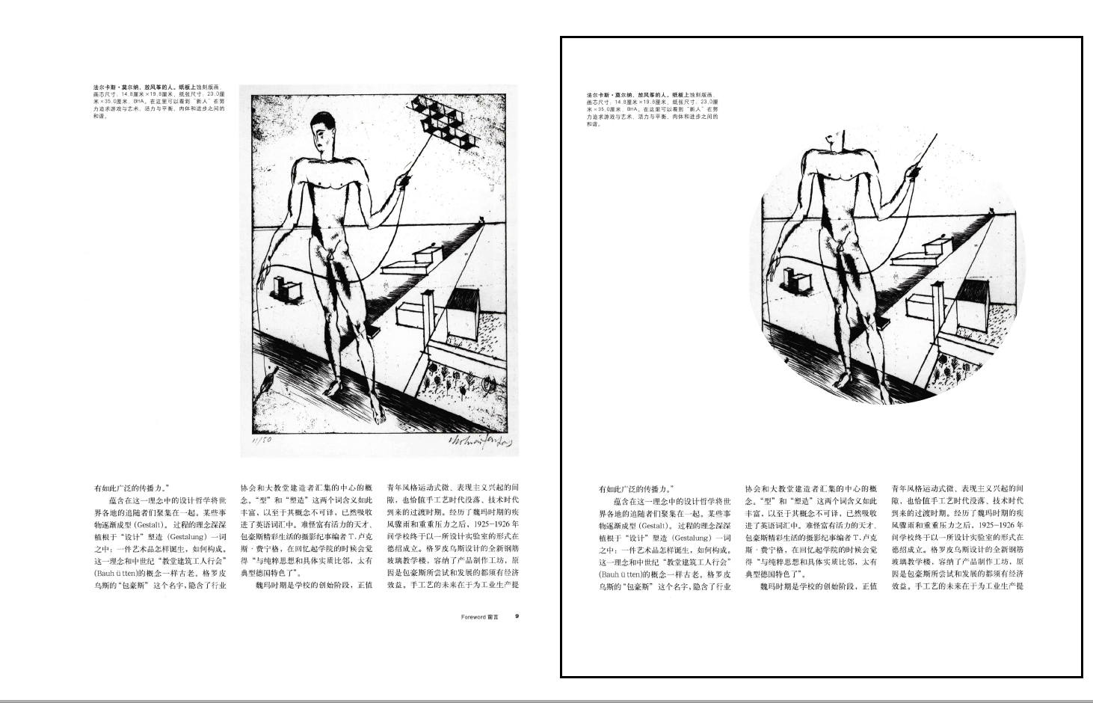
Data I will use

Slide 5
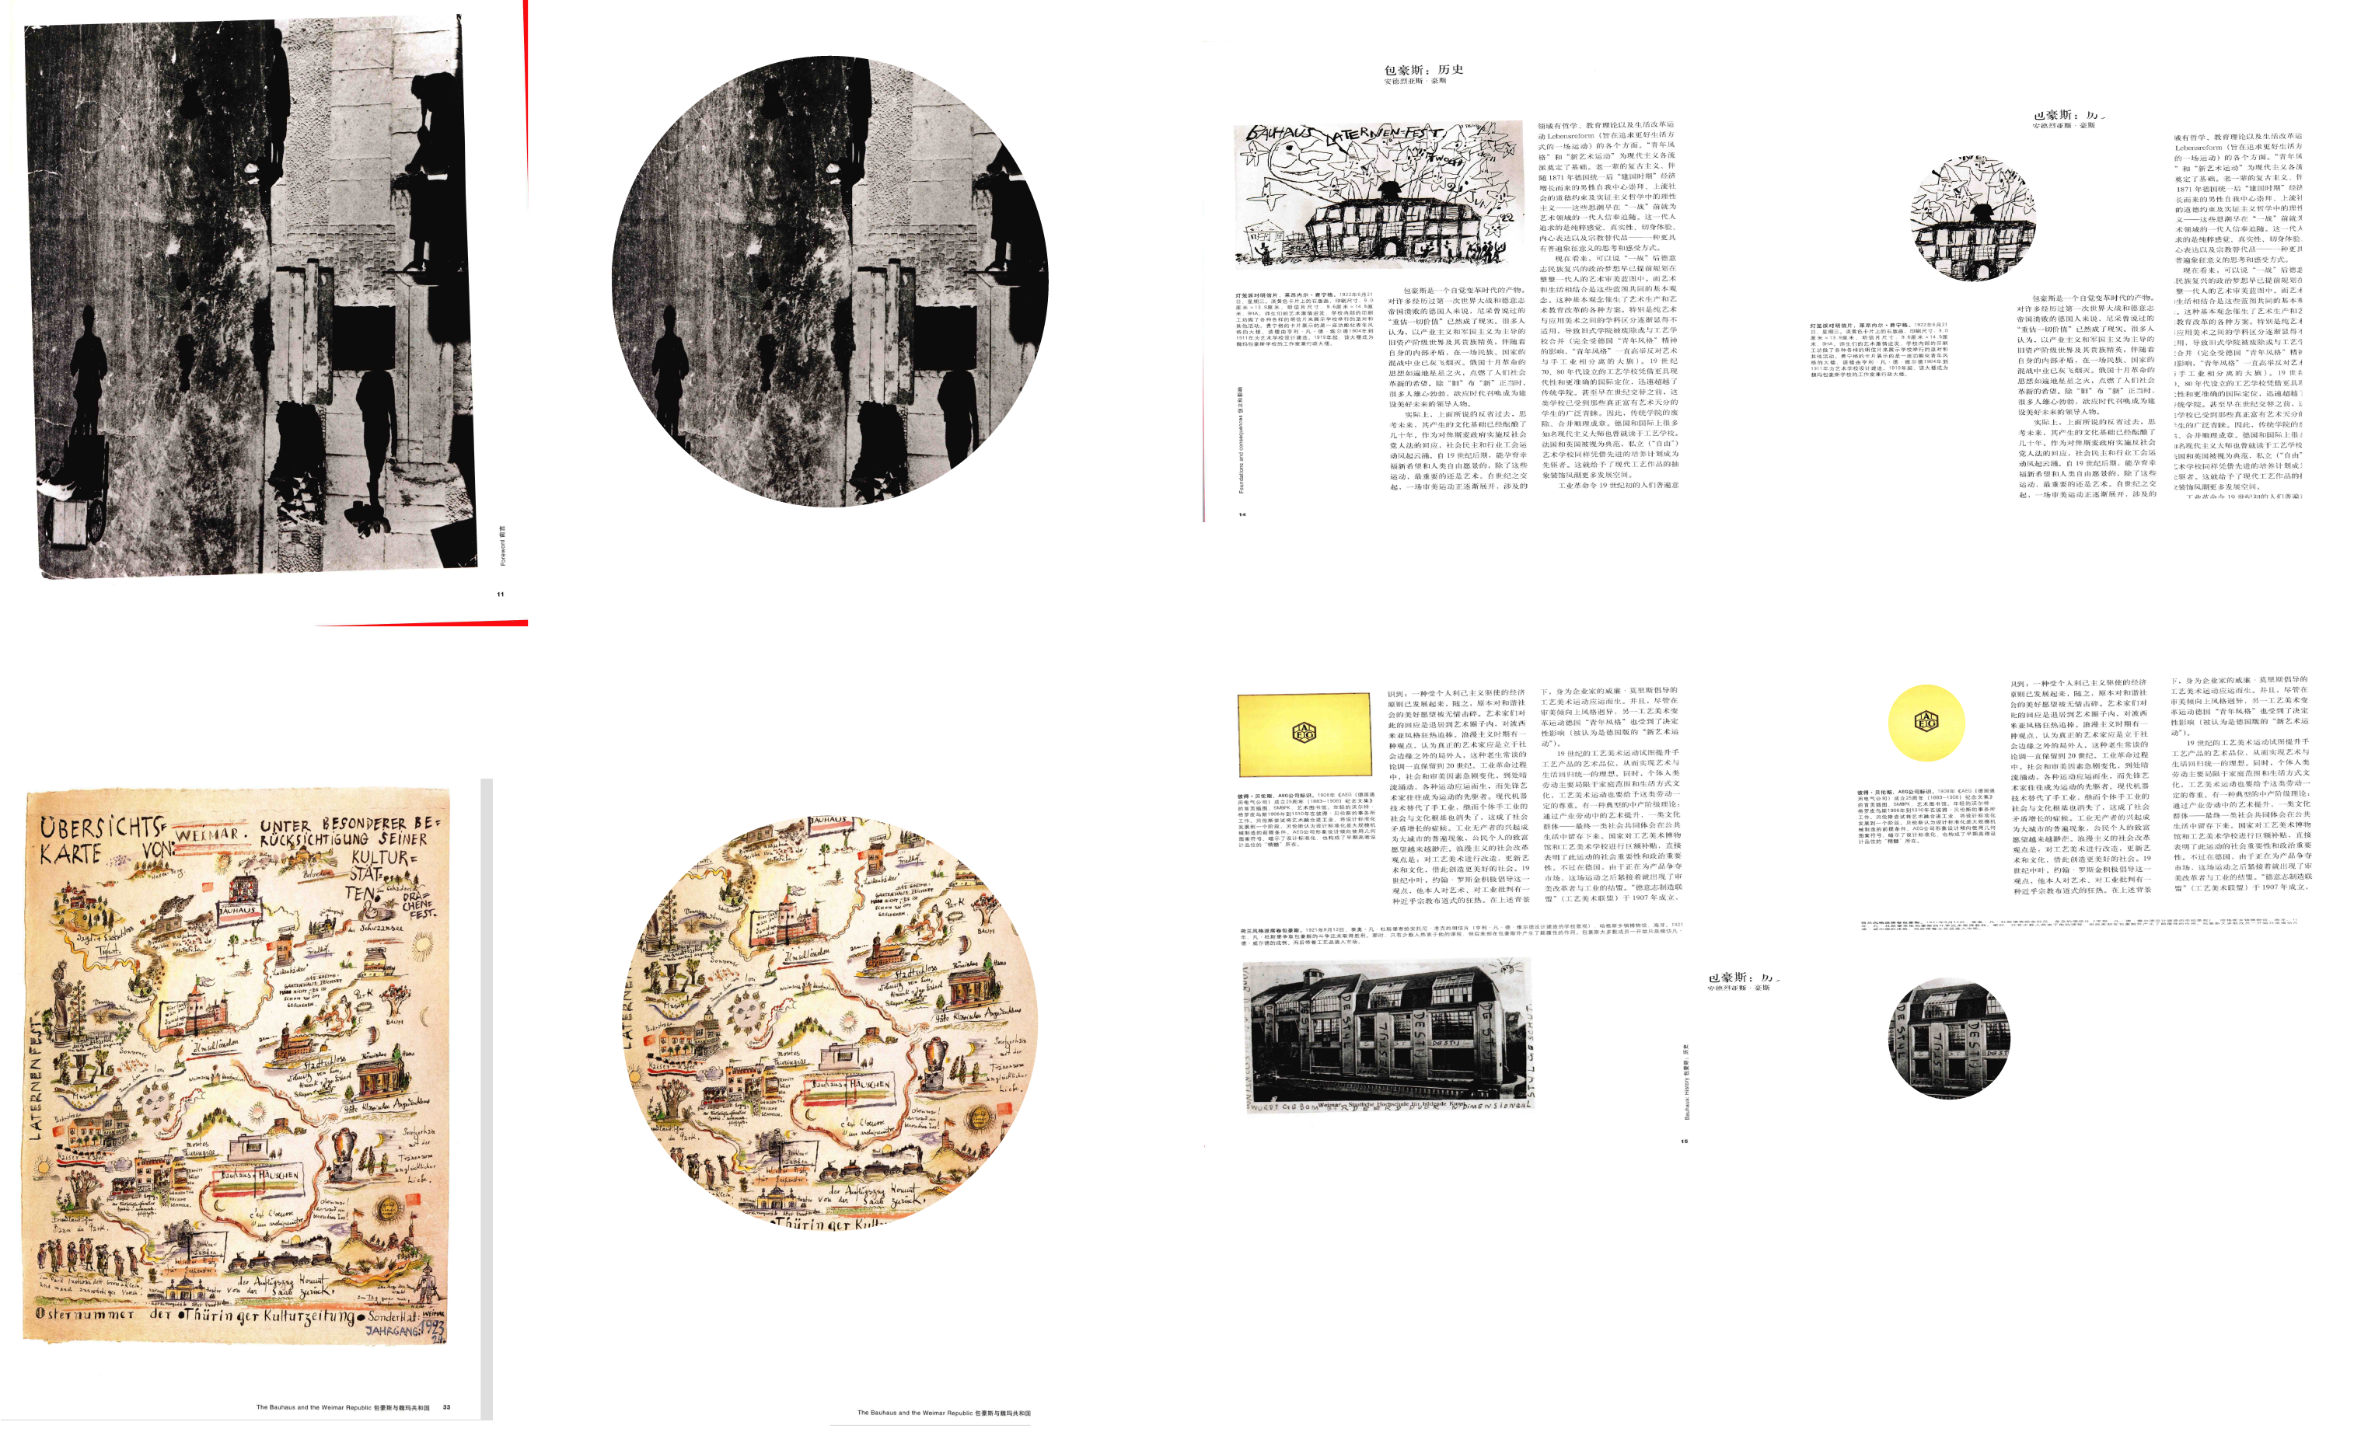

Slide 6
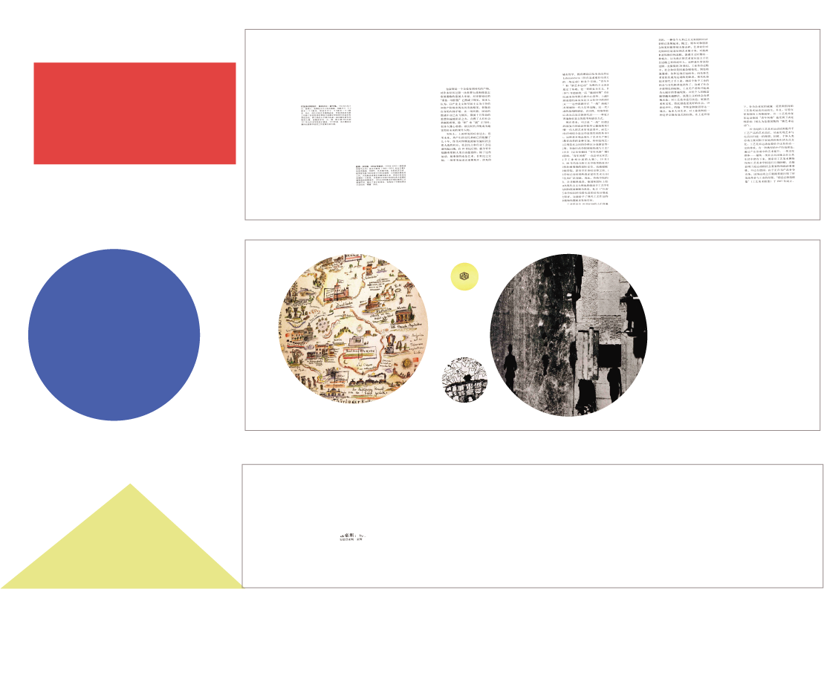

Slide 7
Form Sketches
具体操作：1、选取这本书的其中两百多页贴在墙上拍照（这本书有六百多页，比较多，考虑到时间和效率问题只
选取了其中我们认为比较好的两百多页来操作）
2、剪切每一页的内容，把题目剪成三角形，正文建成矩形，图片剪成圆形。
3、把每页的剪切的内容拼成新的形状，形成了我们自己的语言，同时这个新的符号也代表了书的页书
4、把每一类形状拼在一张纸上，并在每一个形状上标上我们自己语言表达的页书
5、最后按照拼成的形状编订成一本新书
Specific operation: 1. Select more than 200 pages of this book and paste them on the wall to take photos. (This book has more than 600 pages, more than 200 pages are selected to operate, considering the time and efficiency issues.)
2. Cut the content of each page, cut the title into triangles, make the text into rectangles, and cut the pictures into circles.
3. Put the cut content of each page into a new shape and form our own language. At the same time, this new symbol also represents the page book of a book.
4. Put each type of shape together on a piece of paper and mark each shape with a page book in our own language.
5. Finally, a new book is compiled according to the assembled shape.

Slide 8
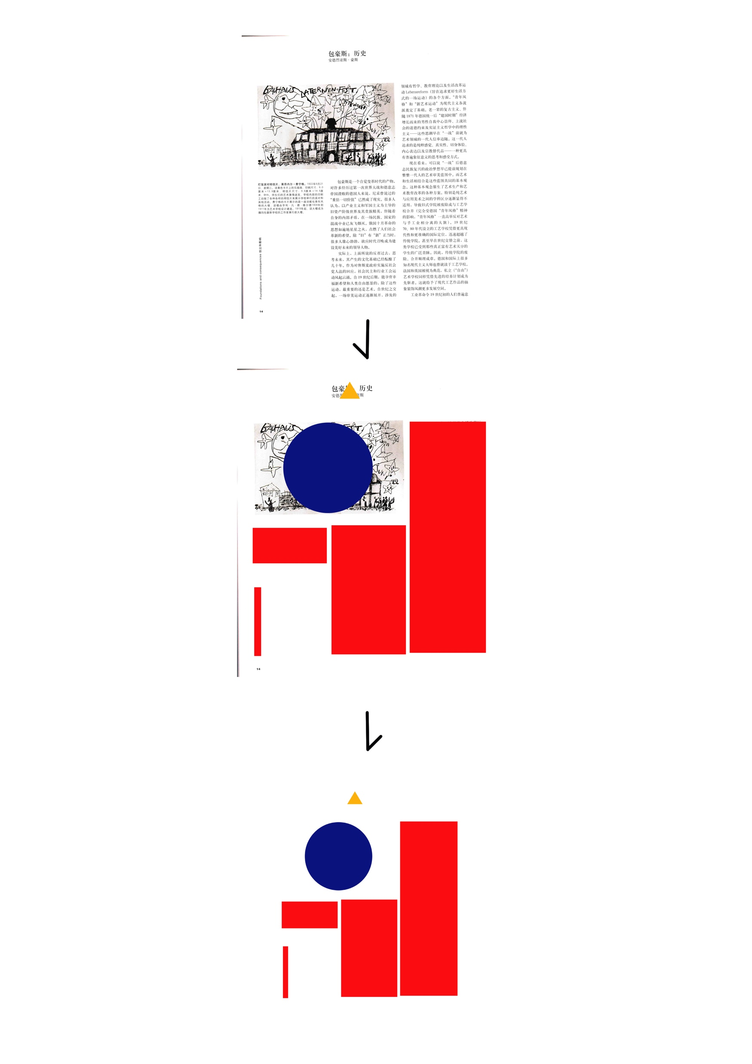
translate the data

Slide 9
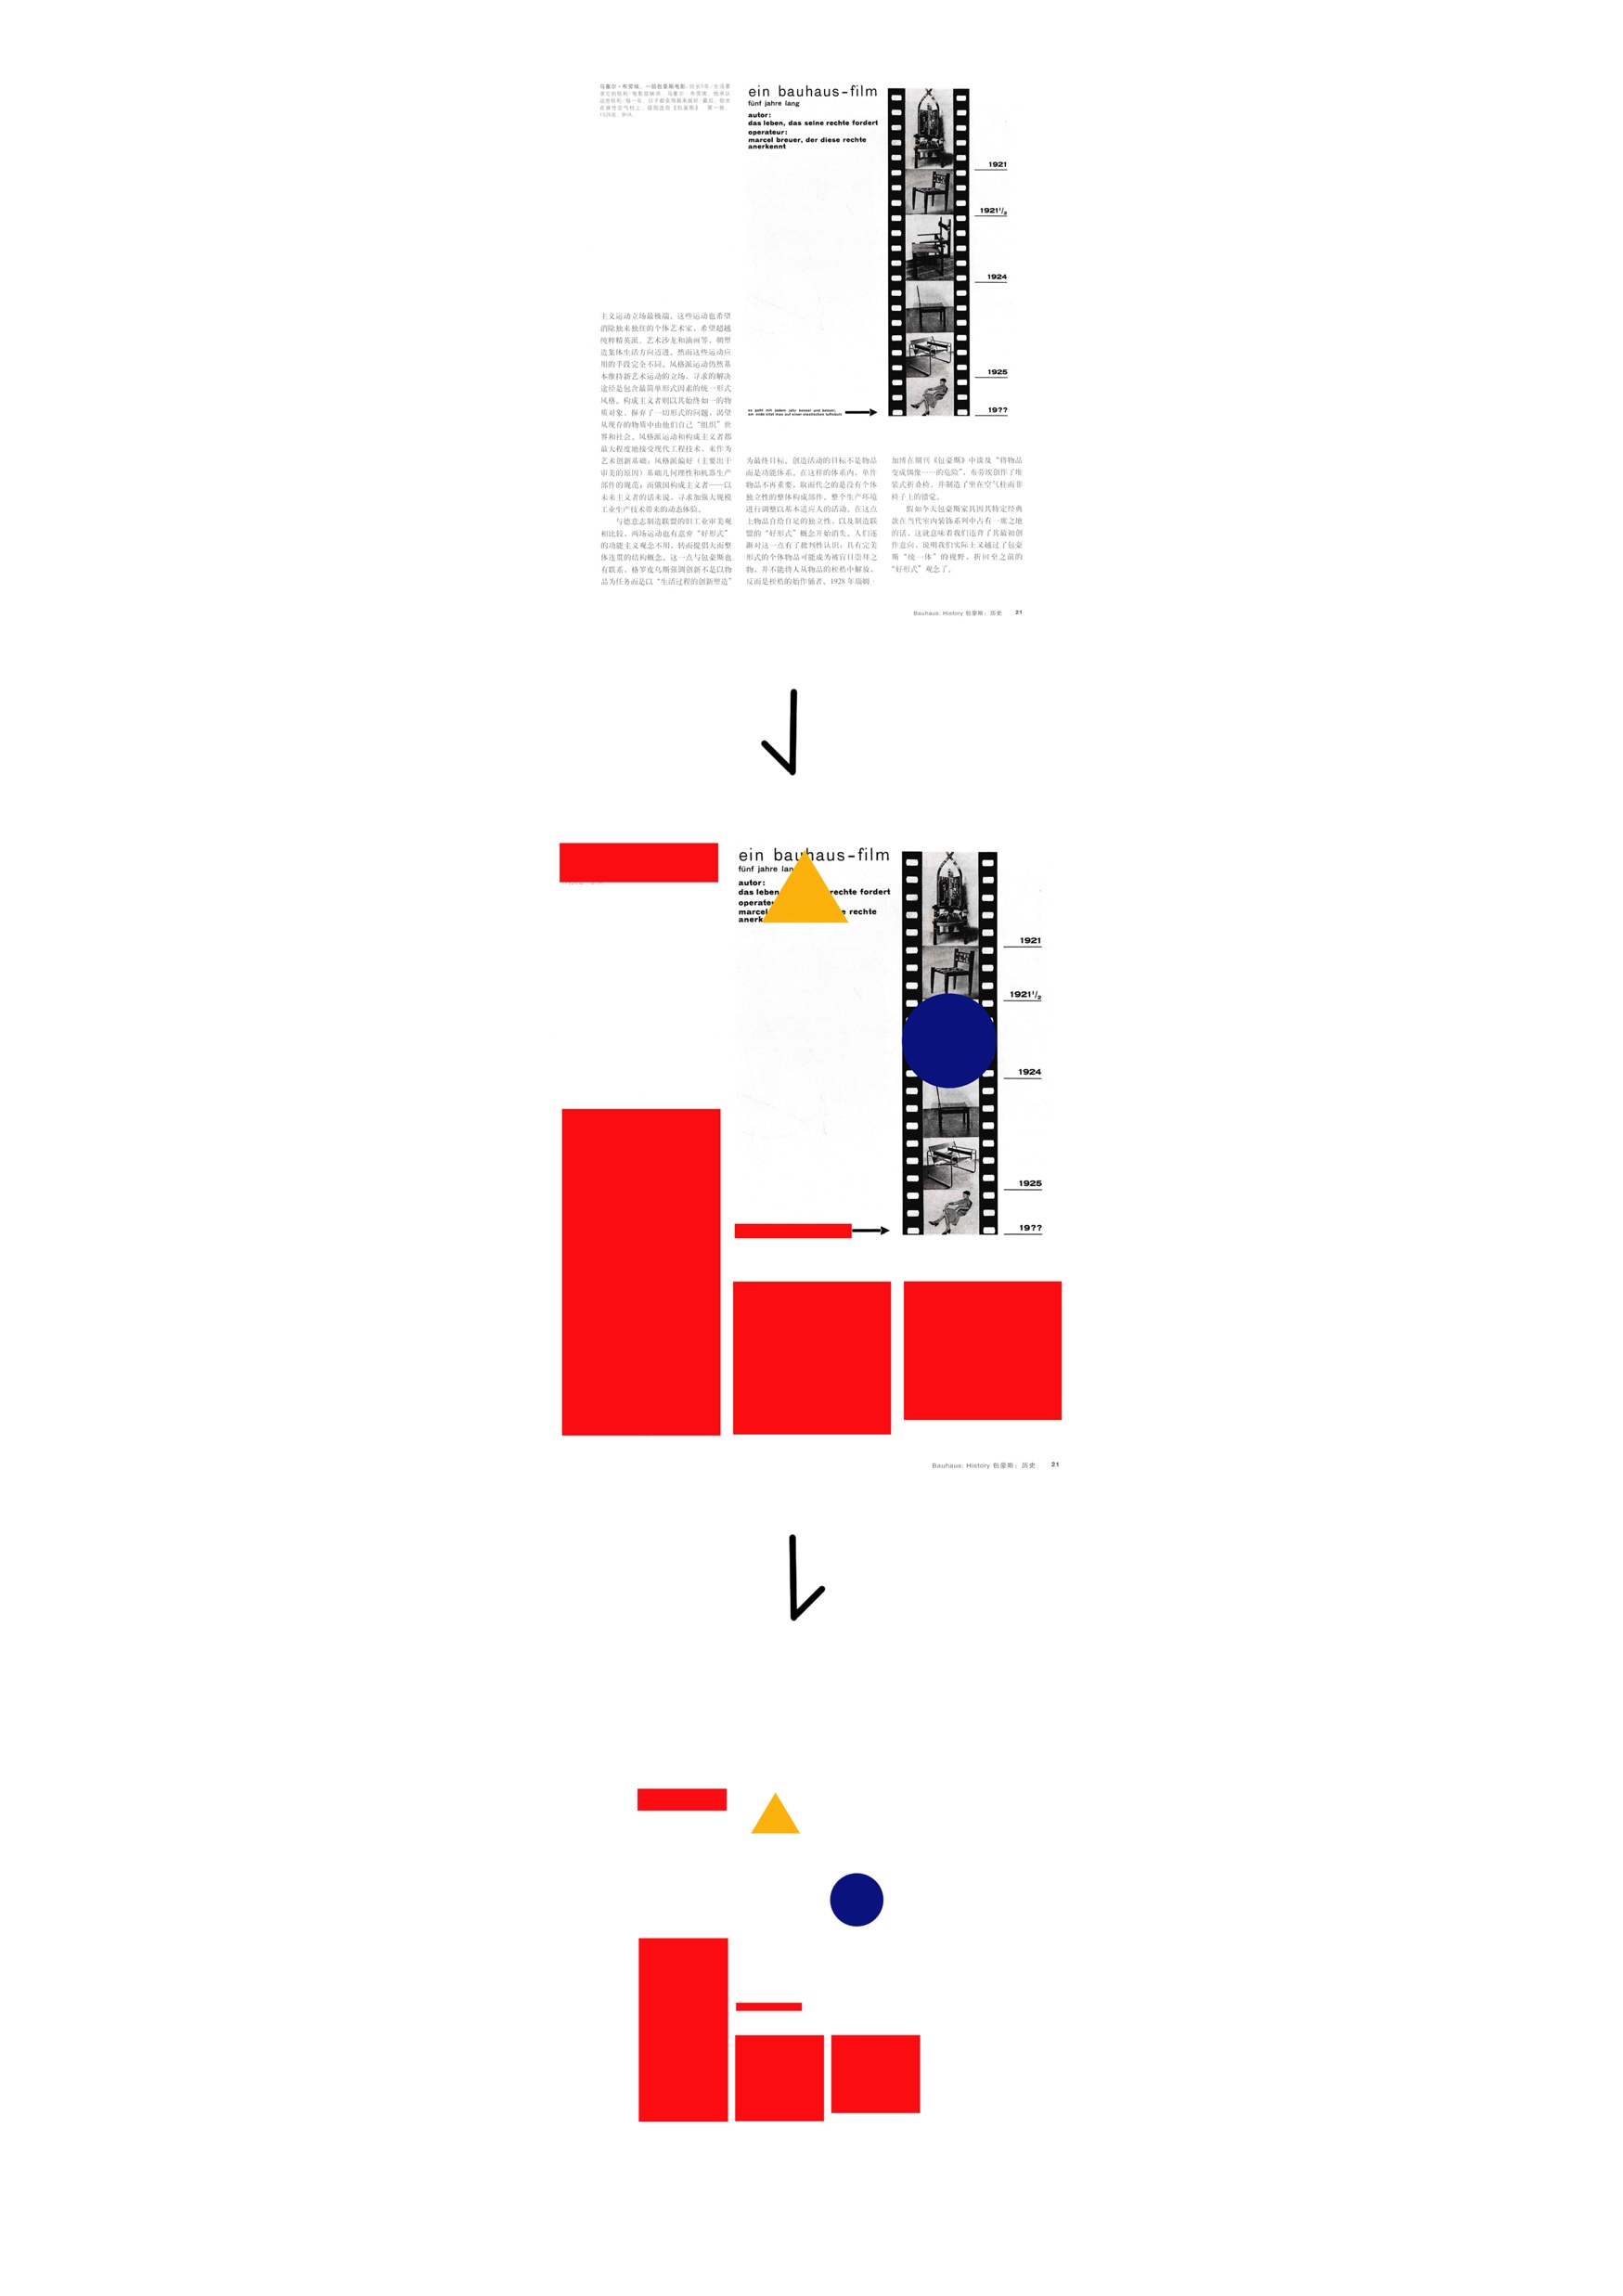
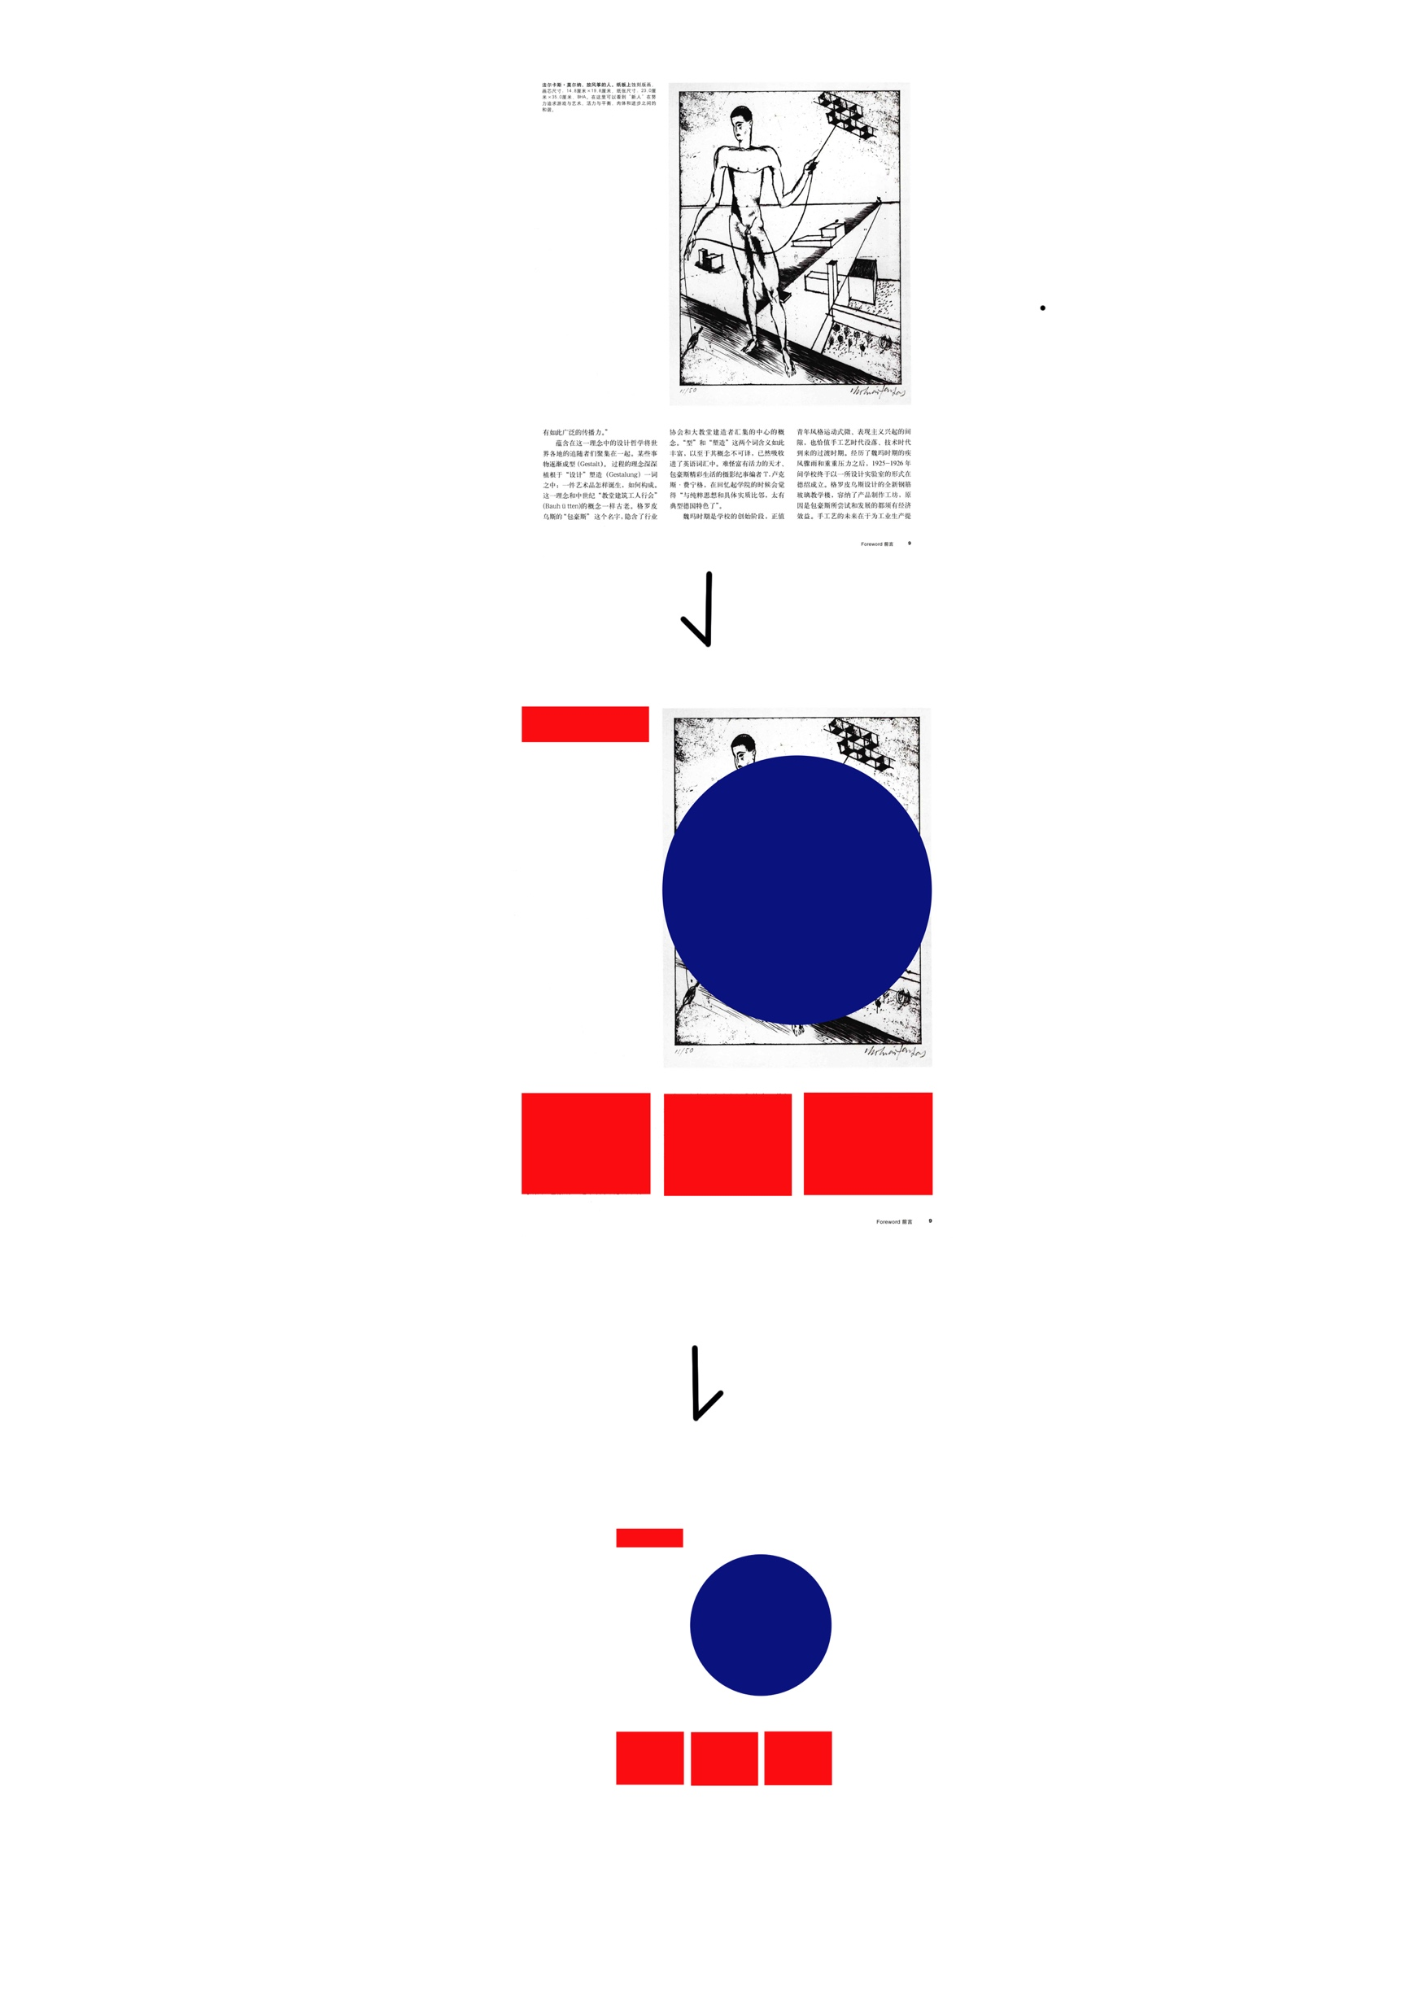
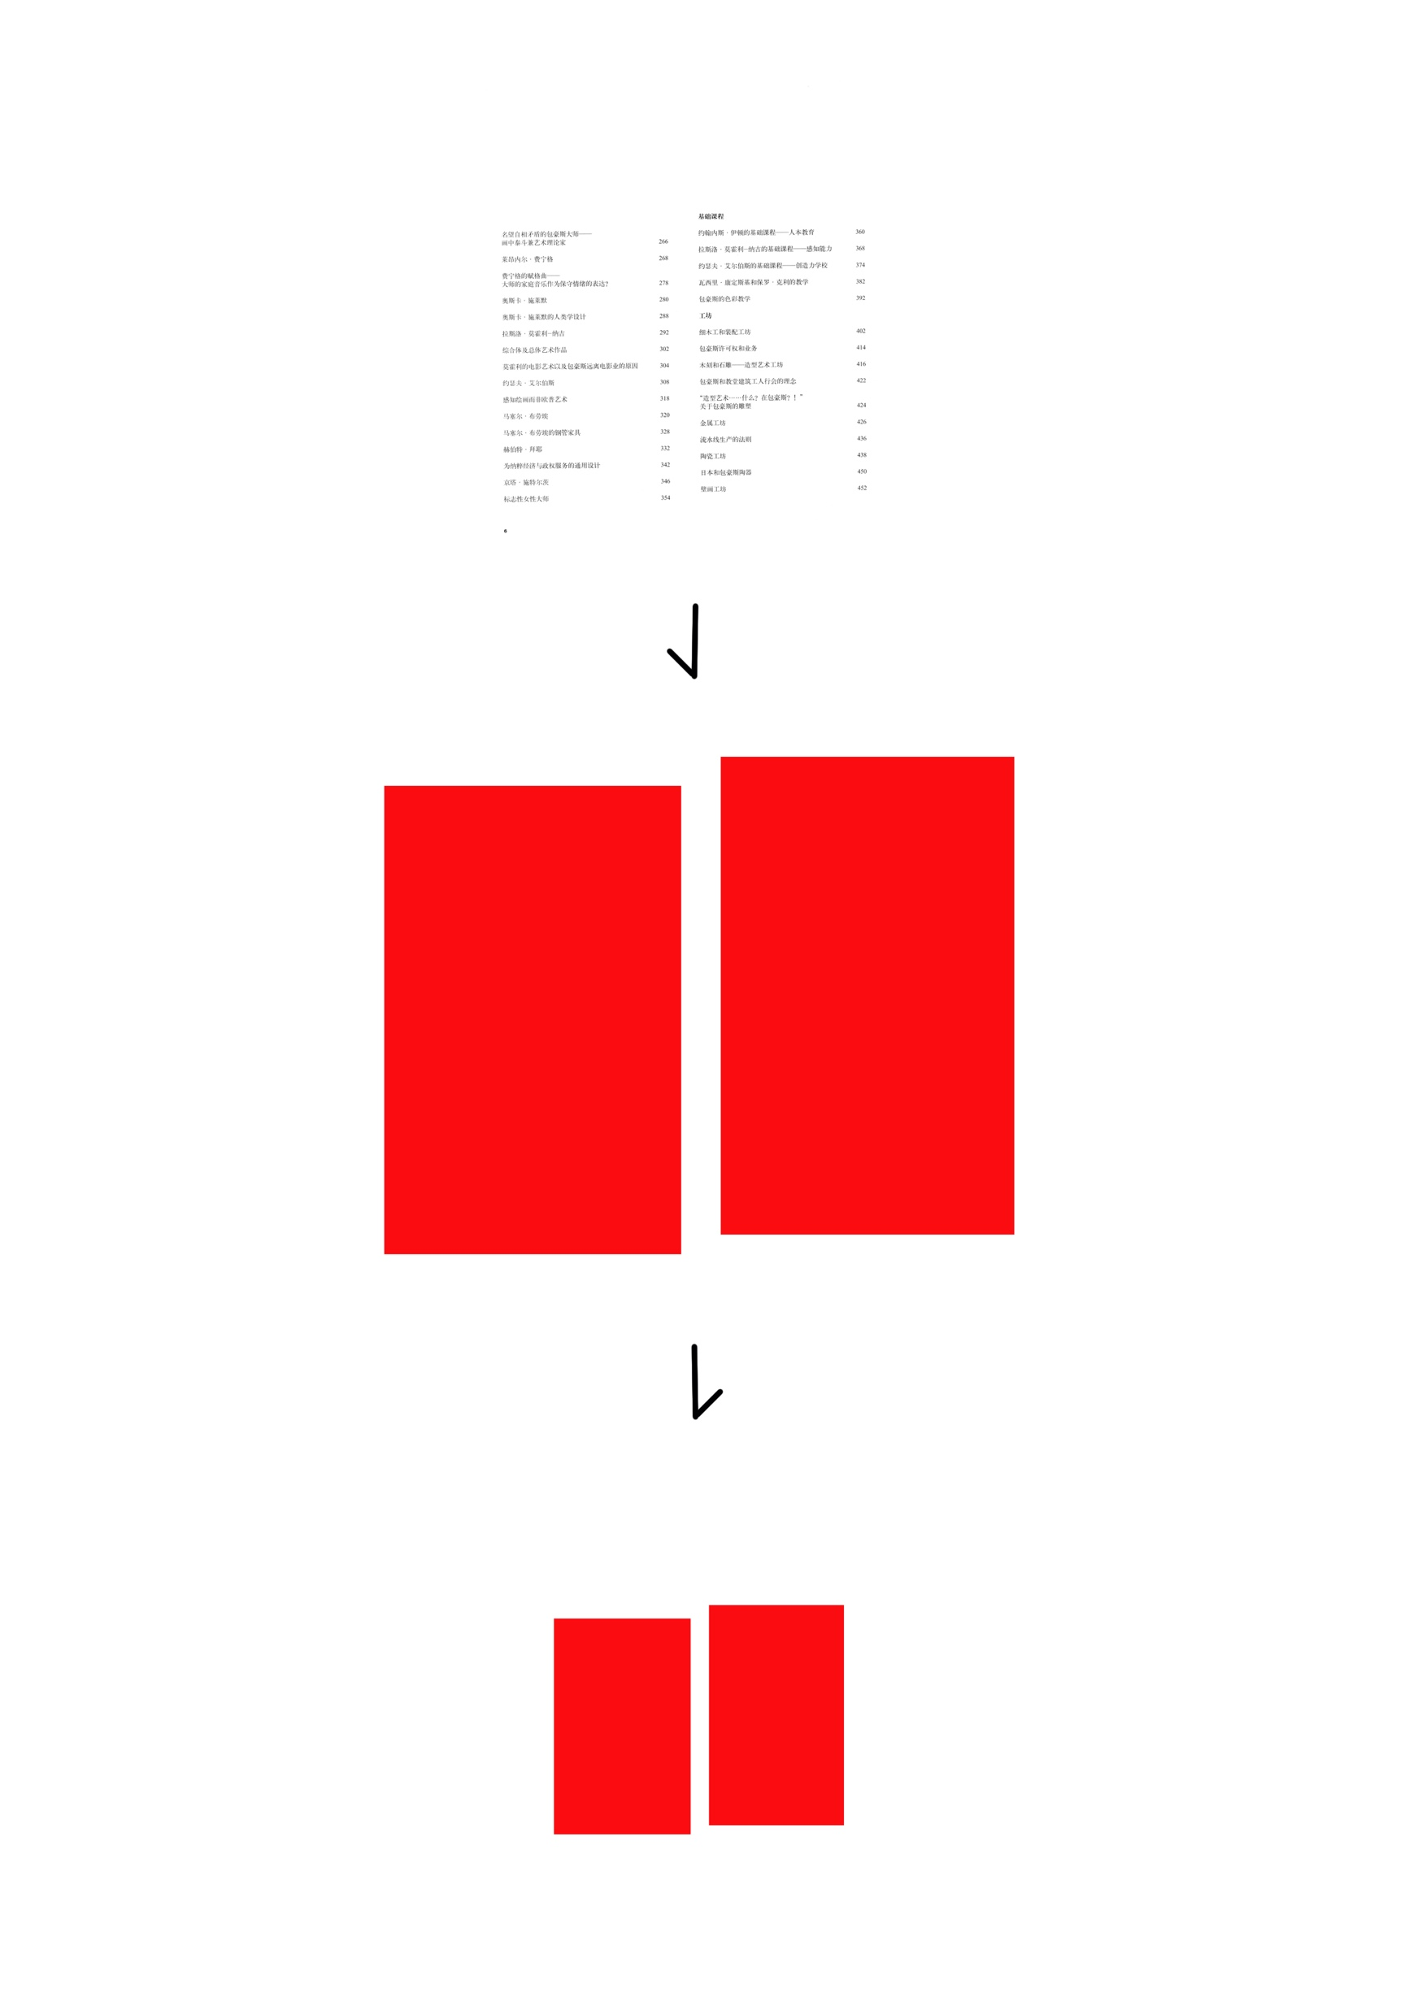

Slide 10
Timeline for Completion (What will I do for the rest of the week?)
We're going to record photos every day,
On the first day, we put the original 200 pages on the wall
The next day, we cut out 200 pages
On the third day, we pasted the cut geometric blocks on the wall again
On the fourth day, we classified the three shapes and added the symbols we made
Day five, organize the books.

Slide 11
Final presentation :
1. Four process diagrams
2. Adapted Books

Slide 12
Thank you

